Slide 1
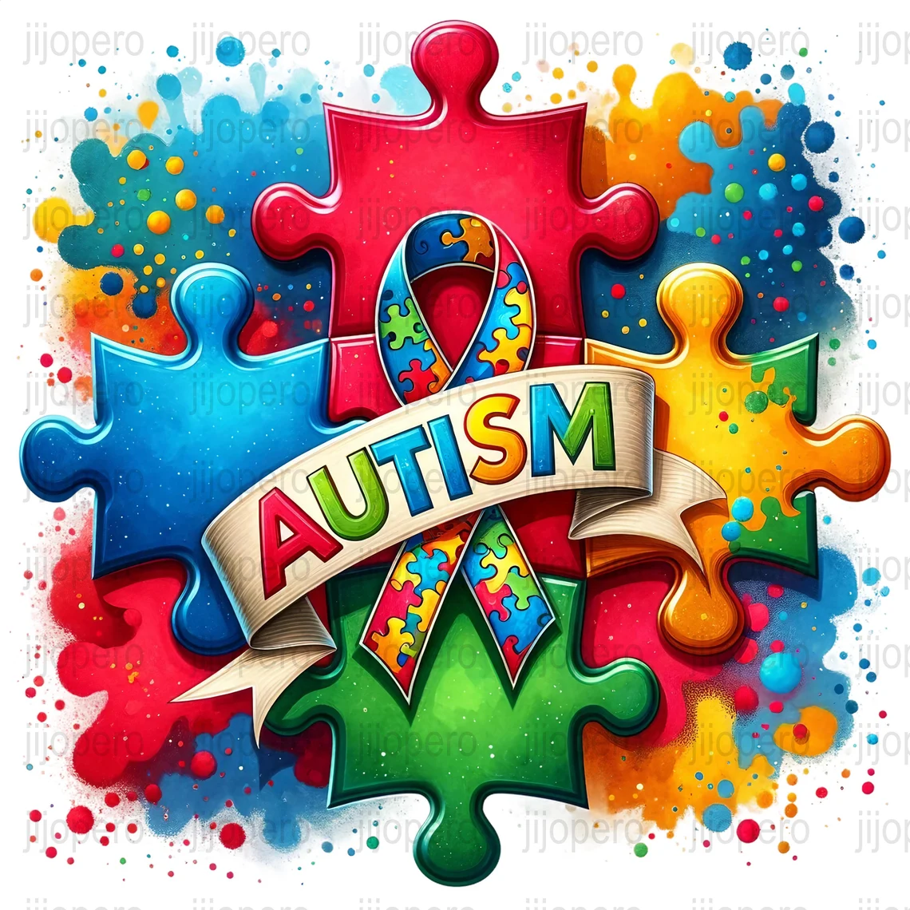

Slide 2
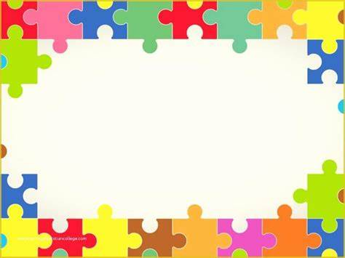
What is Autism?
Autism is a neurodevelopmental disorder that impairs the ability to communicate and interact. It is a complex developmental condition involving persistent challenges with social communication, restricted interests and repetitive behaviors.

Slide 3
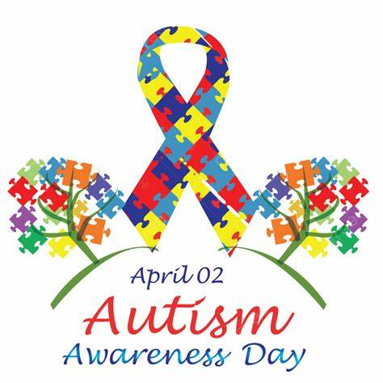
World Autism Awareness Day
World Autism Awareness Day is celebrated on April 2nd of every year.
It was designated by the United nations General Assembly in 2007 to raise awareness and promote acceptance, understanding, and inclusion of individuals with Autism Spectrum Disorder.

Slide 4
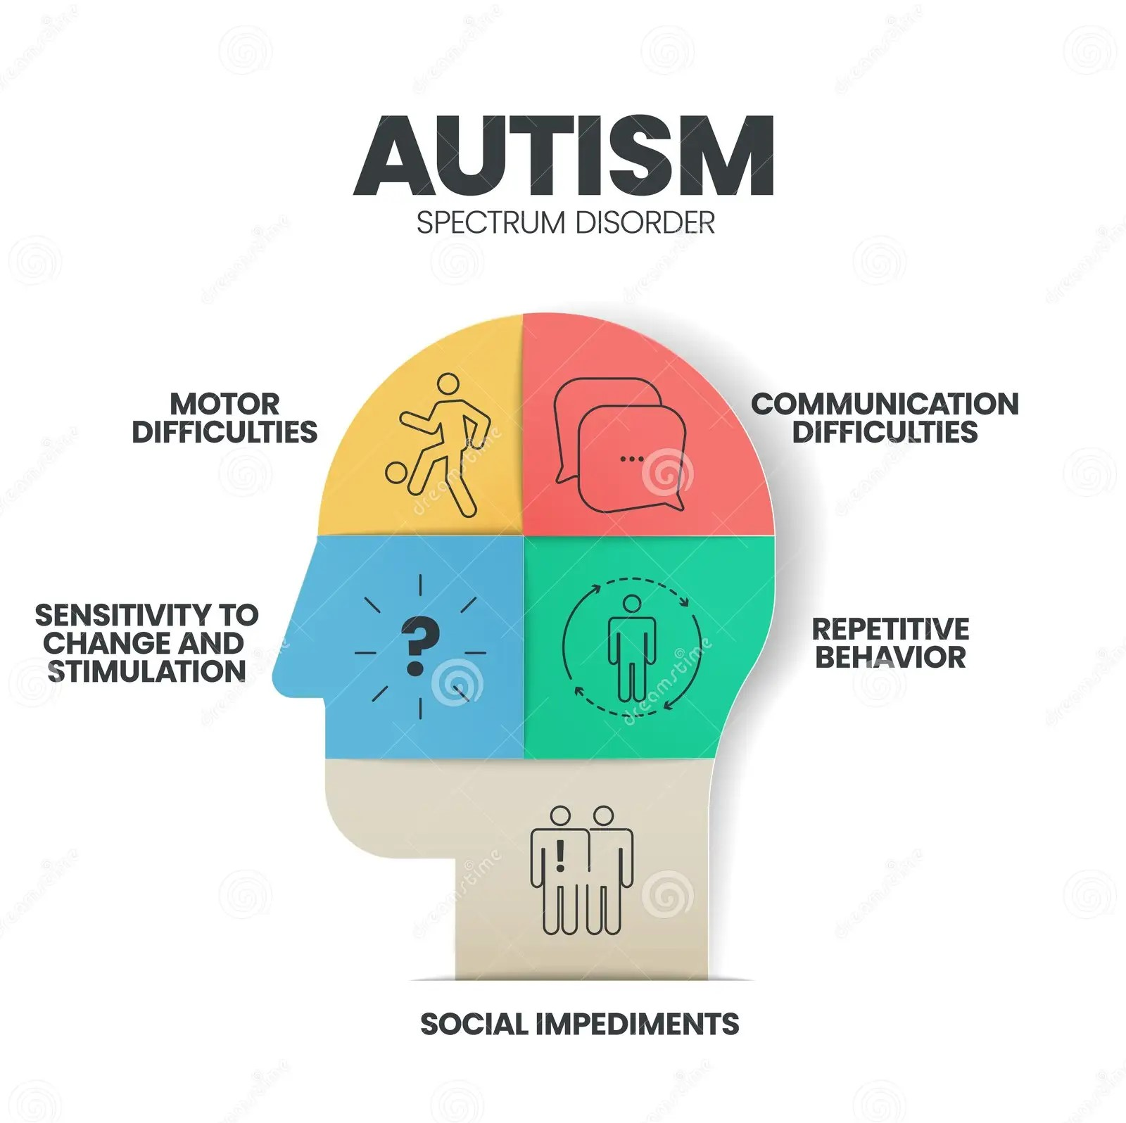
Autism Challenges
Communication difficulty is not understanding the meaning of words and sentences, body language, and vocal tones. Some individuals with autism may have limited speech or be unable to speak.
Social impediments is difficulty interpreting verbal and non-verbal language and understanding how others think and feel.
Sensitivity to change and stimulation is over-responsiveness to sensory stimuli or under-responsiveness. Stimuli such as buzzers, fluorescent lights, loud noises and even food smells.
Motor skills can often be a challenge for an individual with autism such as writing, drawing, and cutting and other motor skills such as running, throwing and kicking.
Repetitive behaviors are movements such as hand-flapping, fidgeting with objects or body rocking, and vocalizations such as grunting or repeating certain phrases.

Slide 5

Autism Opportunities
Many companies actively seek neurodiverse talent, valuing skills like attention to detail, problem-solving, and unique perspectives. Individuals with autism often have strong attention to detail and can thrive in jobs that require accuracy and precision.
Assistive communication devices and apps can enhance communication, while virtual reality environments can facilitate social skills training in a controlled setting.
Encouraging creative expression through music, art, and writing can provide therapeutic benefits and a platform for self-advocacy.

Slide 6
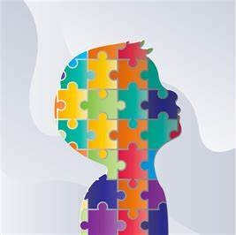
Ethical Concerns
There are concerns that autistic individuals may not give consent to interventions, or that their bodily autonomy may be violated.
The patient’s right to self-determination is frequently violated.
Informed consent must be voluntary without coercion, misrepresentation, duress, or pain.
There are ethical concerns about the risks and benefits of early identification and intervention, and how to communicate early concerns to families.

Slide 7
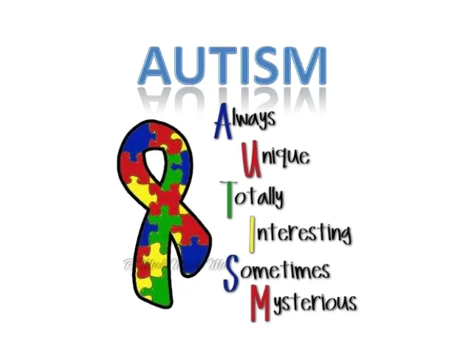
Assumptions
Some assumptions about an individual with autism are they have a special skill, they are violent, they can’t feel emotion or have relationships.
Another assumption about autism is that autism need to be cured. This perspective can marginalize the neurodiversity movement, which advocates for acceptance and appreciation of neurological difference.

Slide 8
